Slide 1
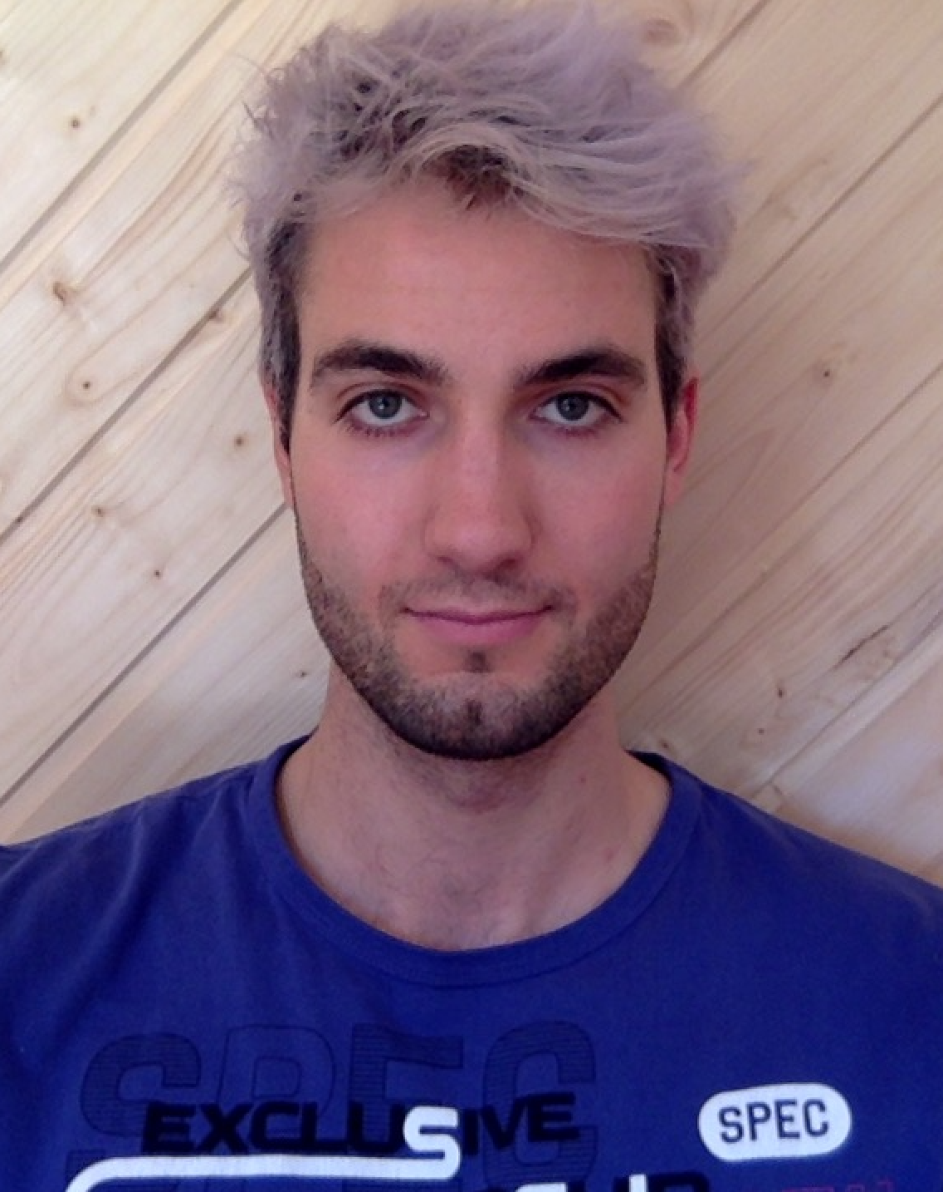
Human Live Pose Estimation Using PifPaf
Professor:
Student:
Assistant:
Alexandre Alahi
Jonathan Kaeser
Sven Kreiss
June 2019
Visual Intelligence for Transportation VITA : https://www.epfl.ch/labs/vita/

Slide 2
https://www.epfl.ch/labs/vita/

Slide 3
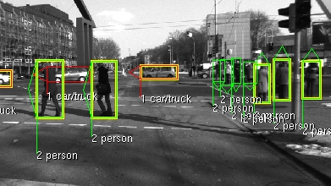
http://www.cvlibs.net/datasets/karlsruhe_objects/

Slide 4

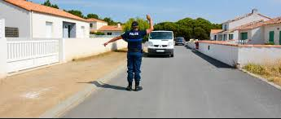


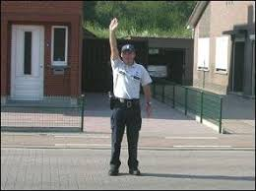

Slide 5
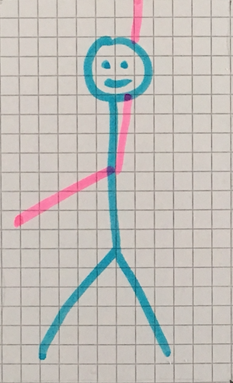
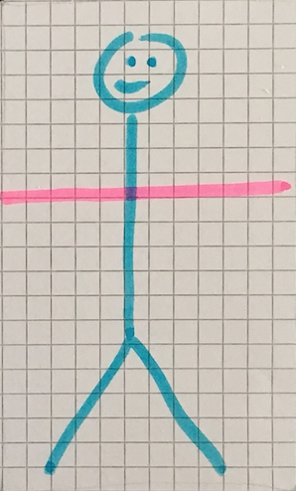
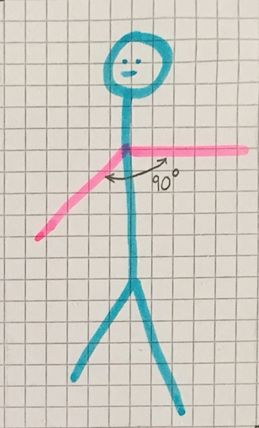
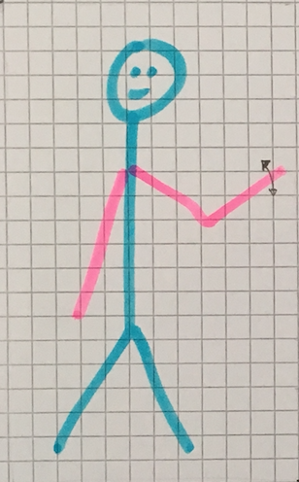
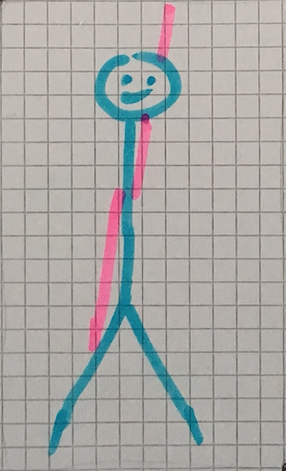

Slide 6
https://www.epfl.ch/labs/vita/

Slide 7
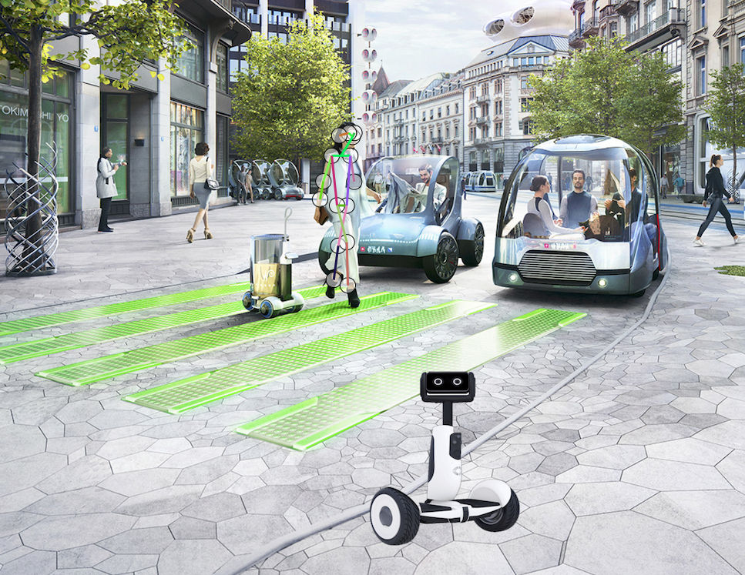
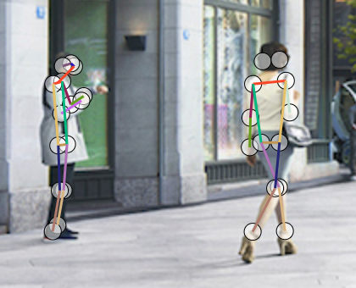
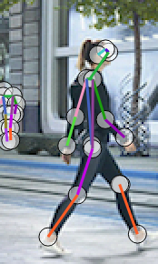
Use the PifPaf algorithm… (https://www.epfl.ch/labs/vita/research/perception/pifpaf/)

Slide 8
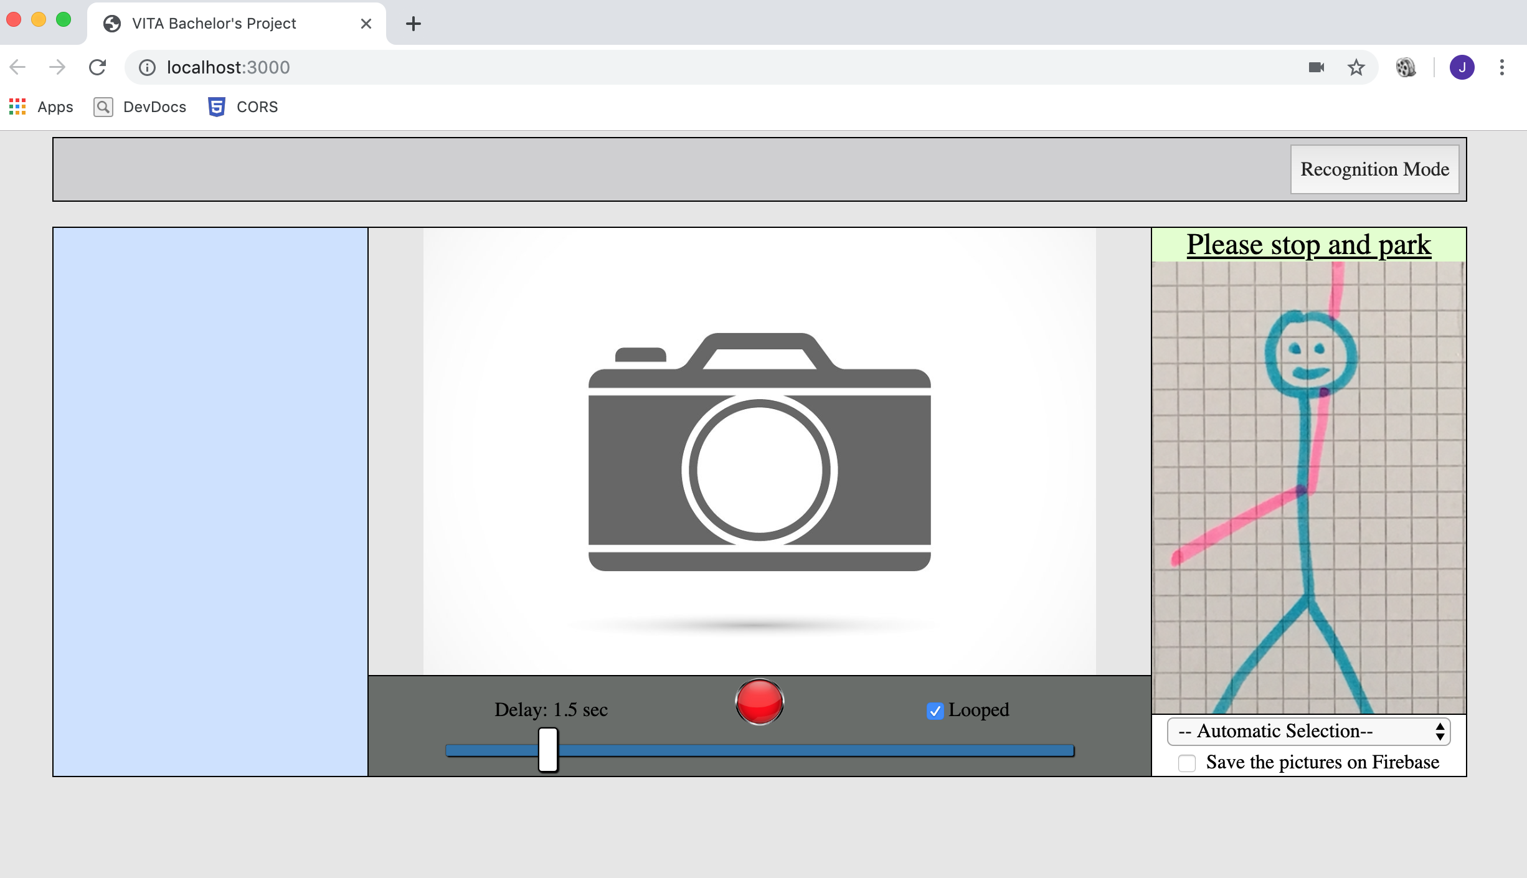
Use the PifPaf algorithm…
…in combination with a new interface…

Slide 9
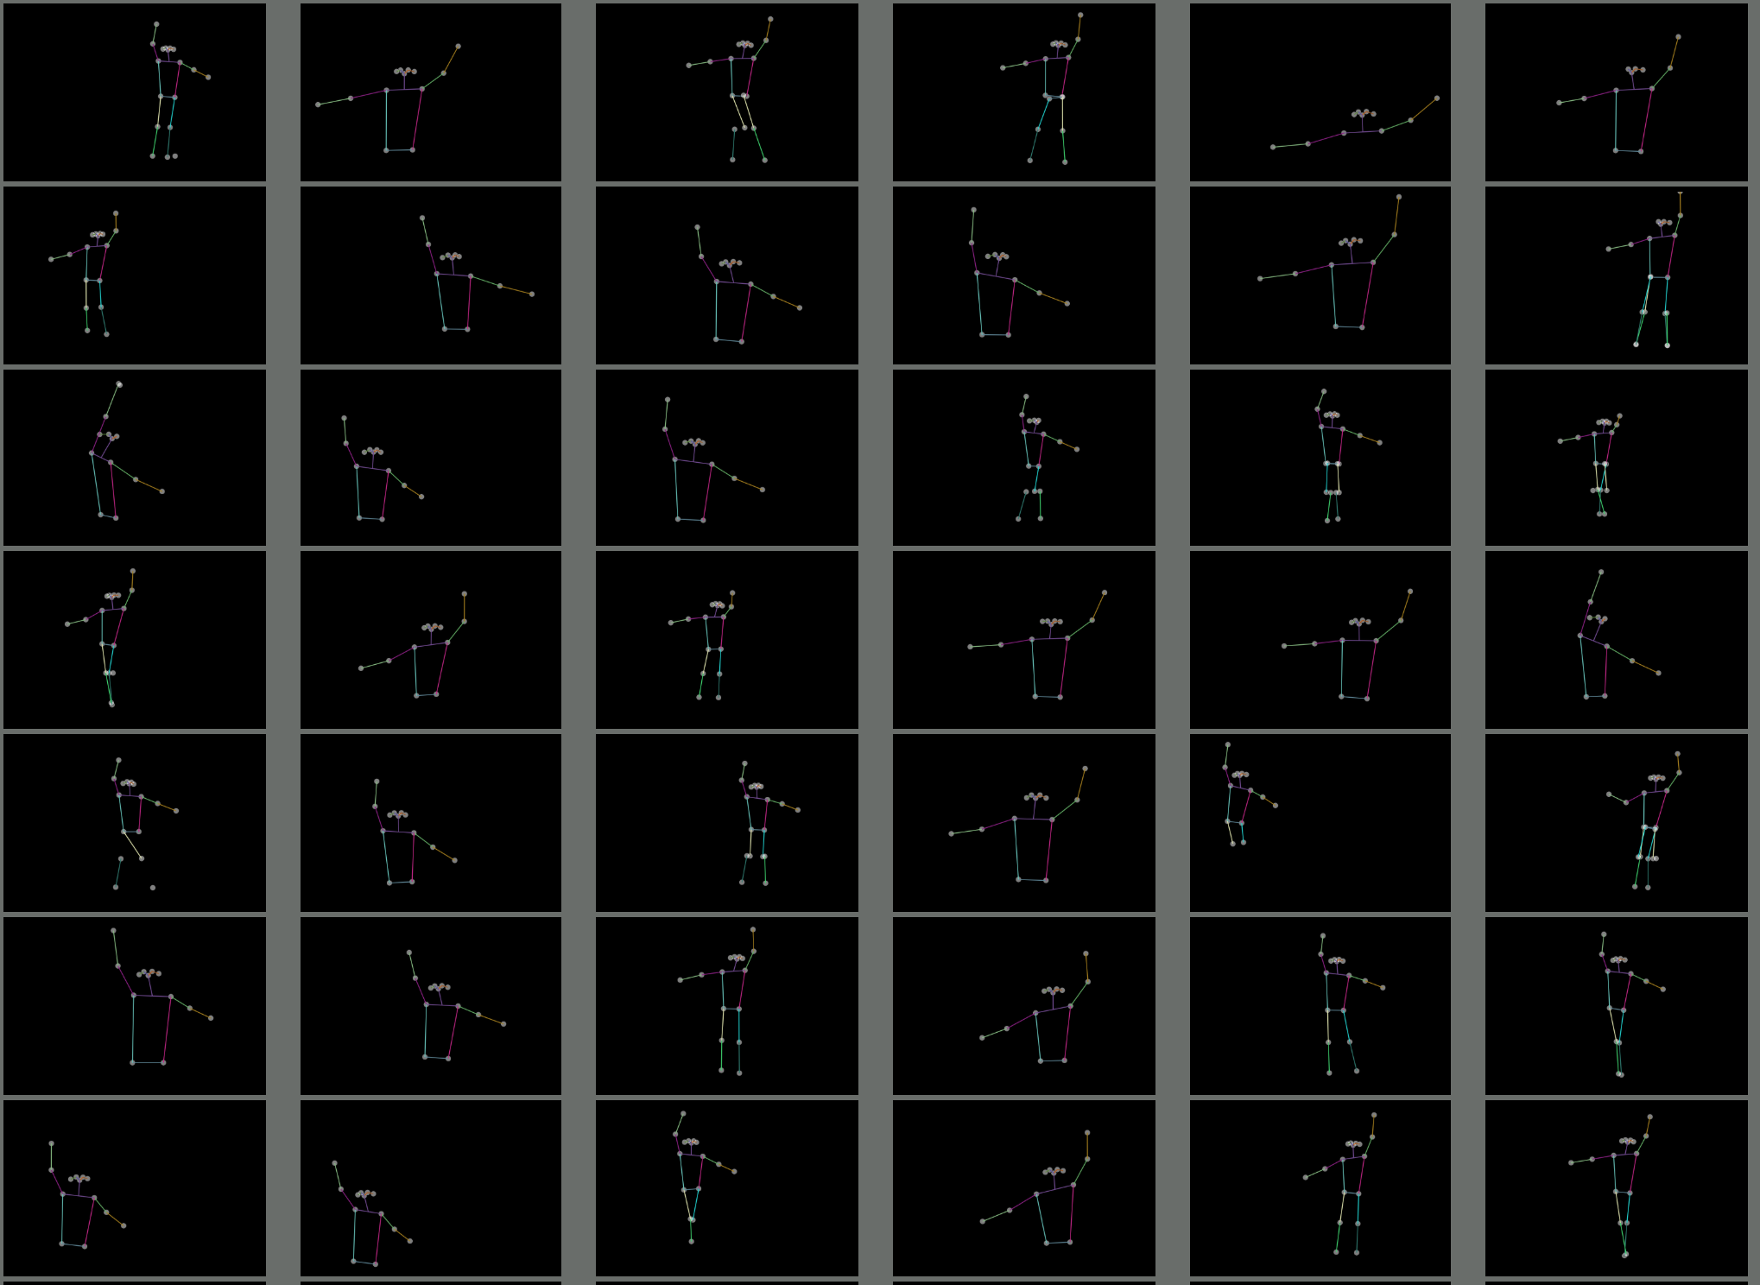
Use the PifPaf algorithm…
…in combination with a new interface…
… to get a training set …

Slide 10
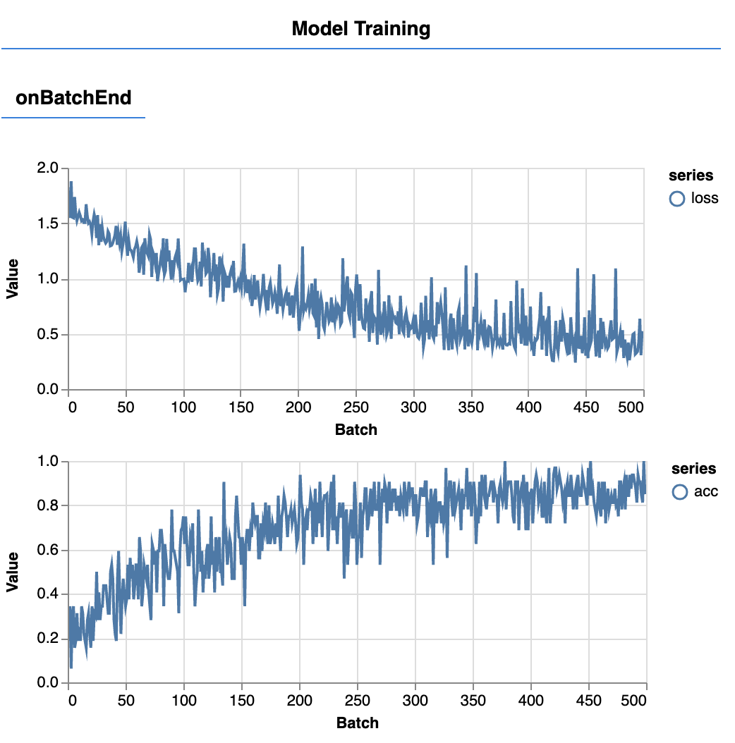
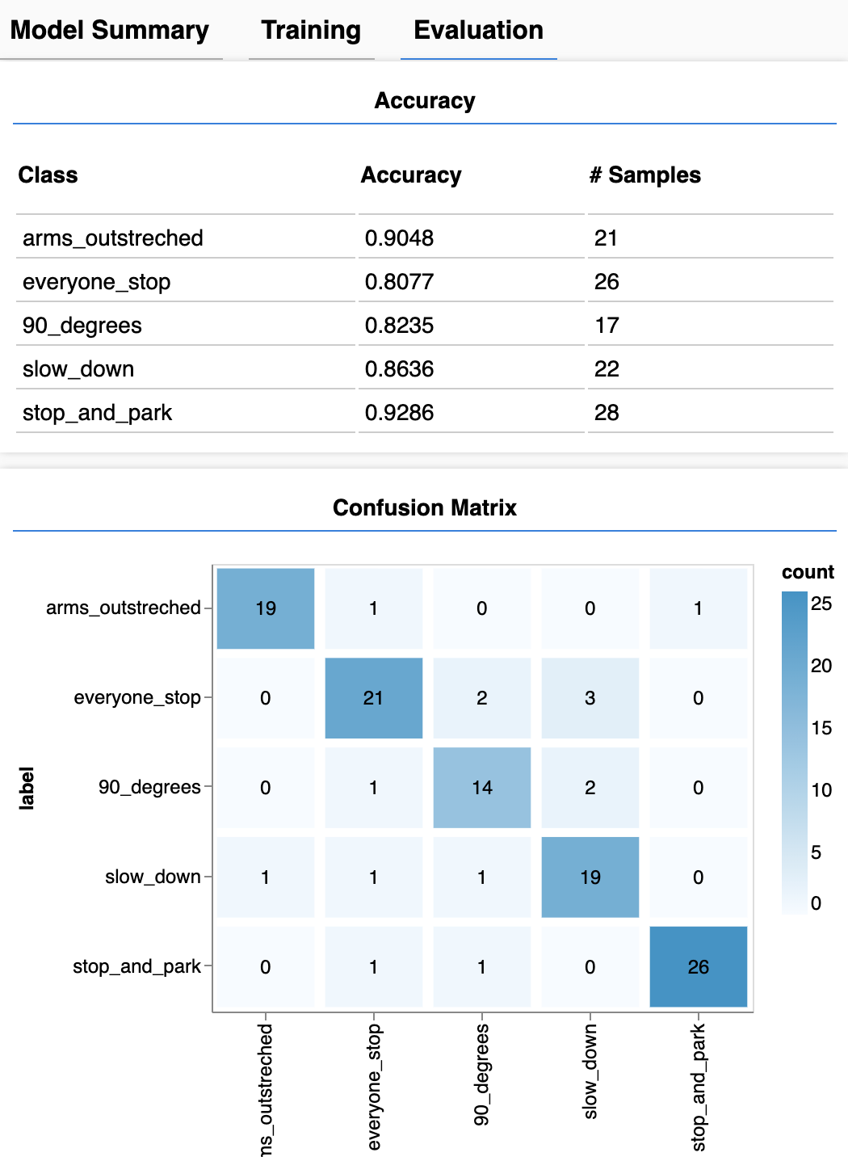
Use the PifPaf algorithm…
…in combination with a new interface…
… to get a training set .
Then train a neural network on top of it
…and finally integrate the result in the interface

Slide 11
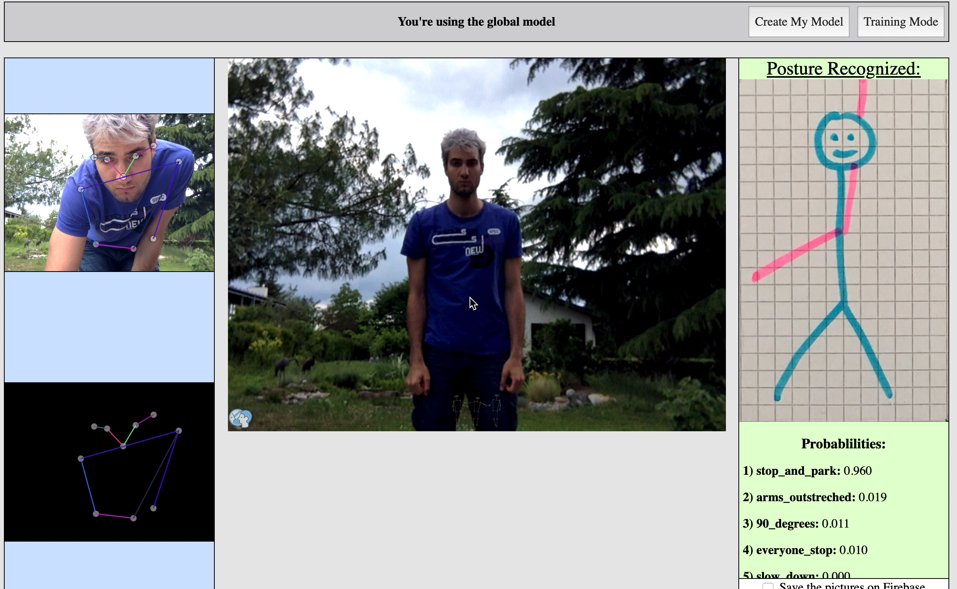
Use the PifPaf algorithm…
…in combination with a new interface…
… to get a training set .
Then train a neural network on top of it
…and finally integrate the result in the interface

Slide 12
All the source code of this web application is available at:
https://github.com/LaFrimousse/VITAProject

Slide 13

But how did I do it ?
That’s great !!!

Slide 14
But how did I do it ?
That’s great !!!

Slide 15
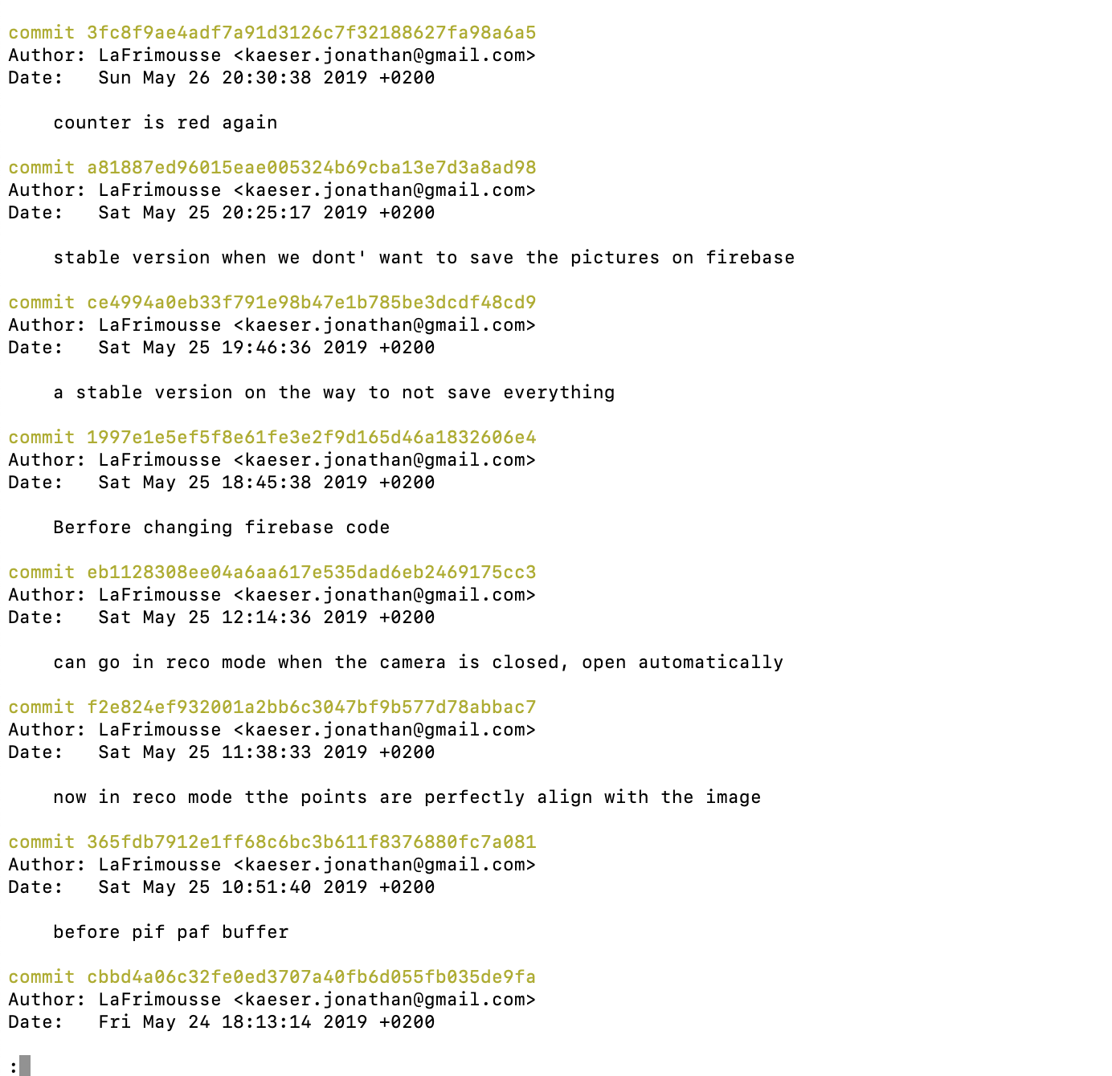
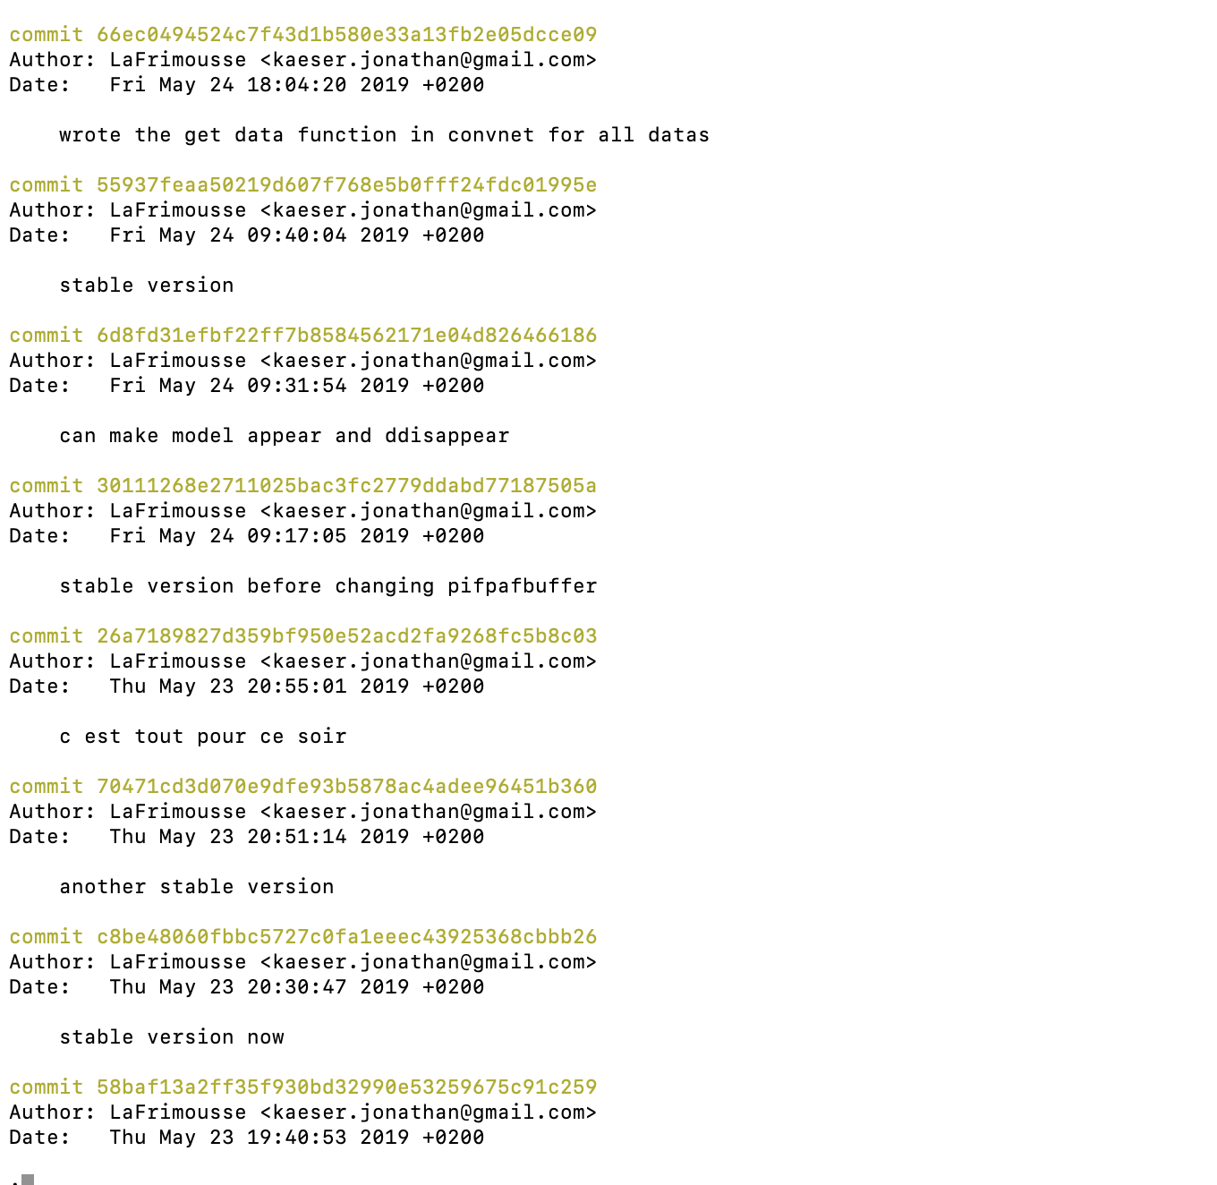
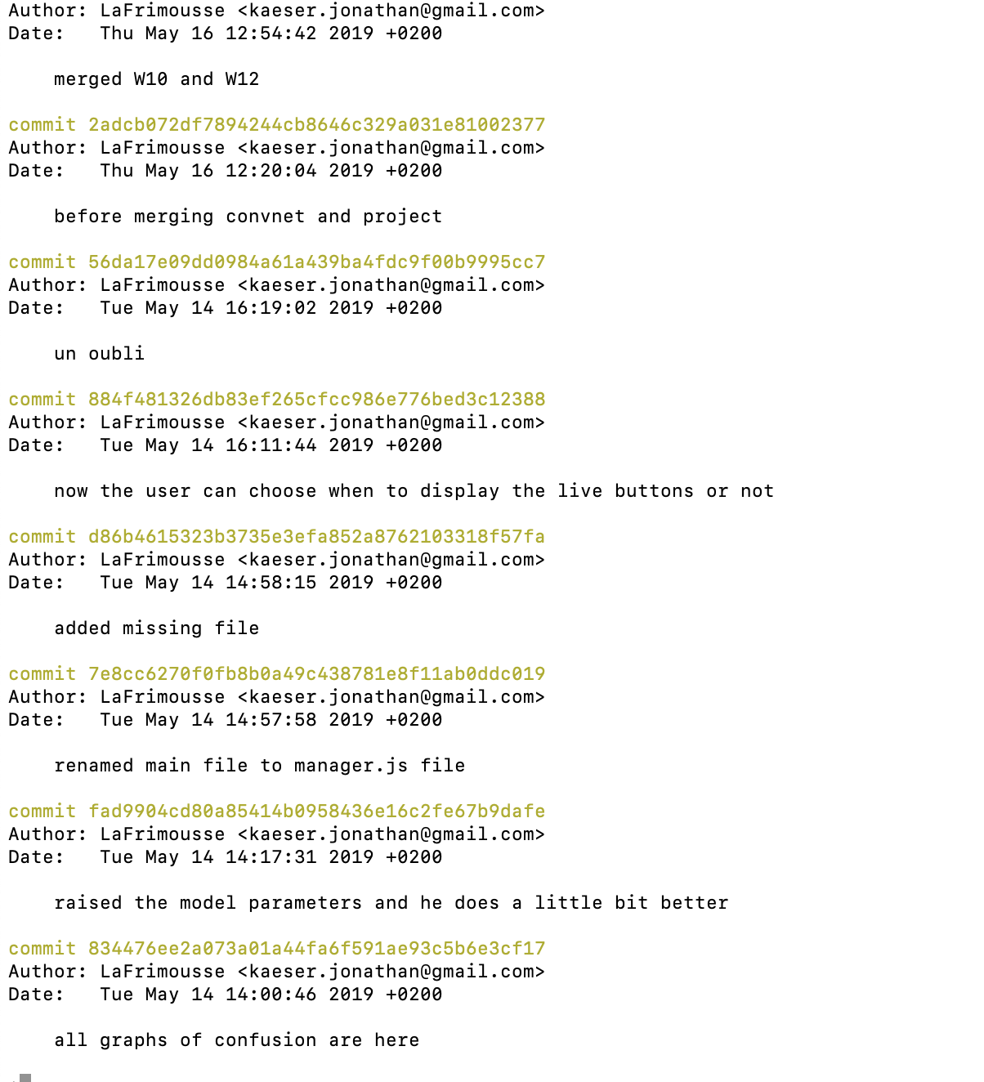
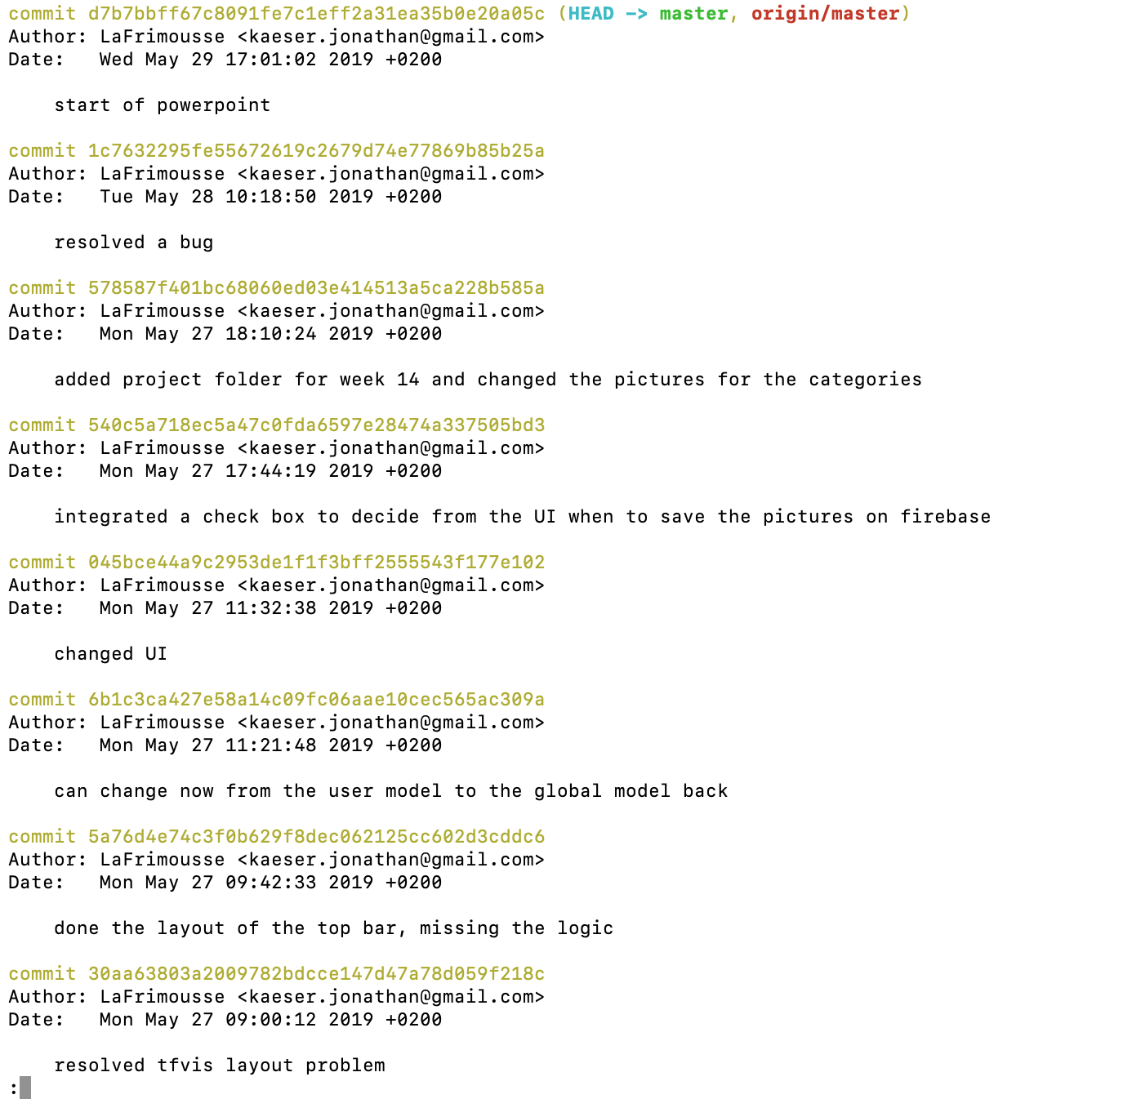
Well, it’s a long series of commit.

Slide 16
And all I had at the beginning was some…
… skills

Slide 17
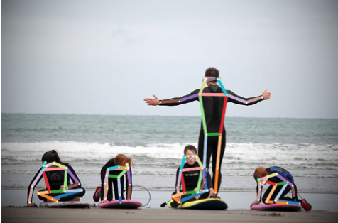
And for sure access to the PifPaf source code available on GitHub

Slide 18
Project’s History

Slide 19
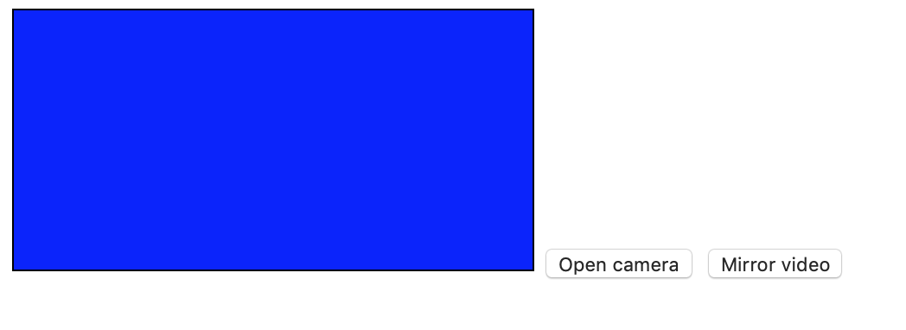
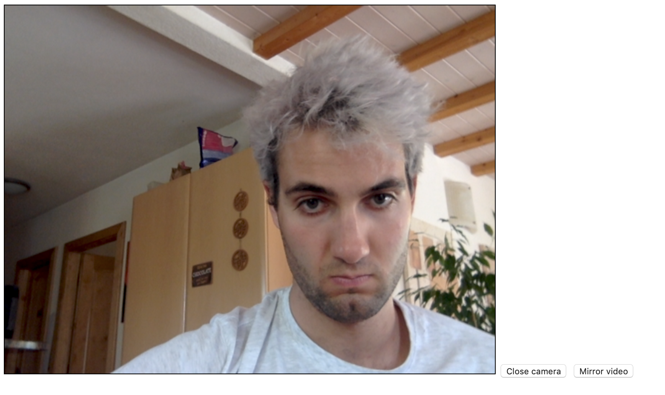
First weeks:
Followed some tutorial to handle the camera in a web browser

Slide 20
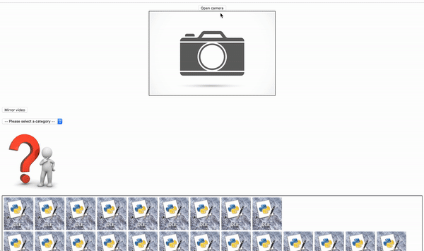
First weeks:
Followed some tutorial to handle the camera in a web browser
Then learned how to render the frame in a canvas to take some picture, and I did it in a loop
(The pictures were already saved locally under 3 categories)

Slide 21

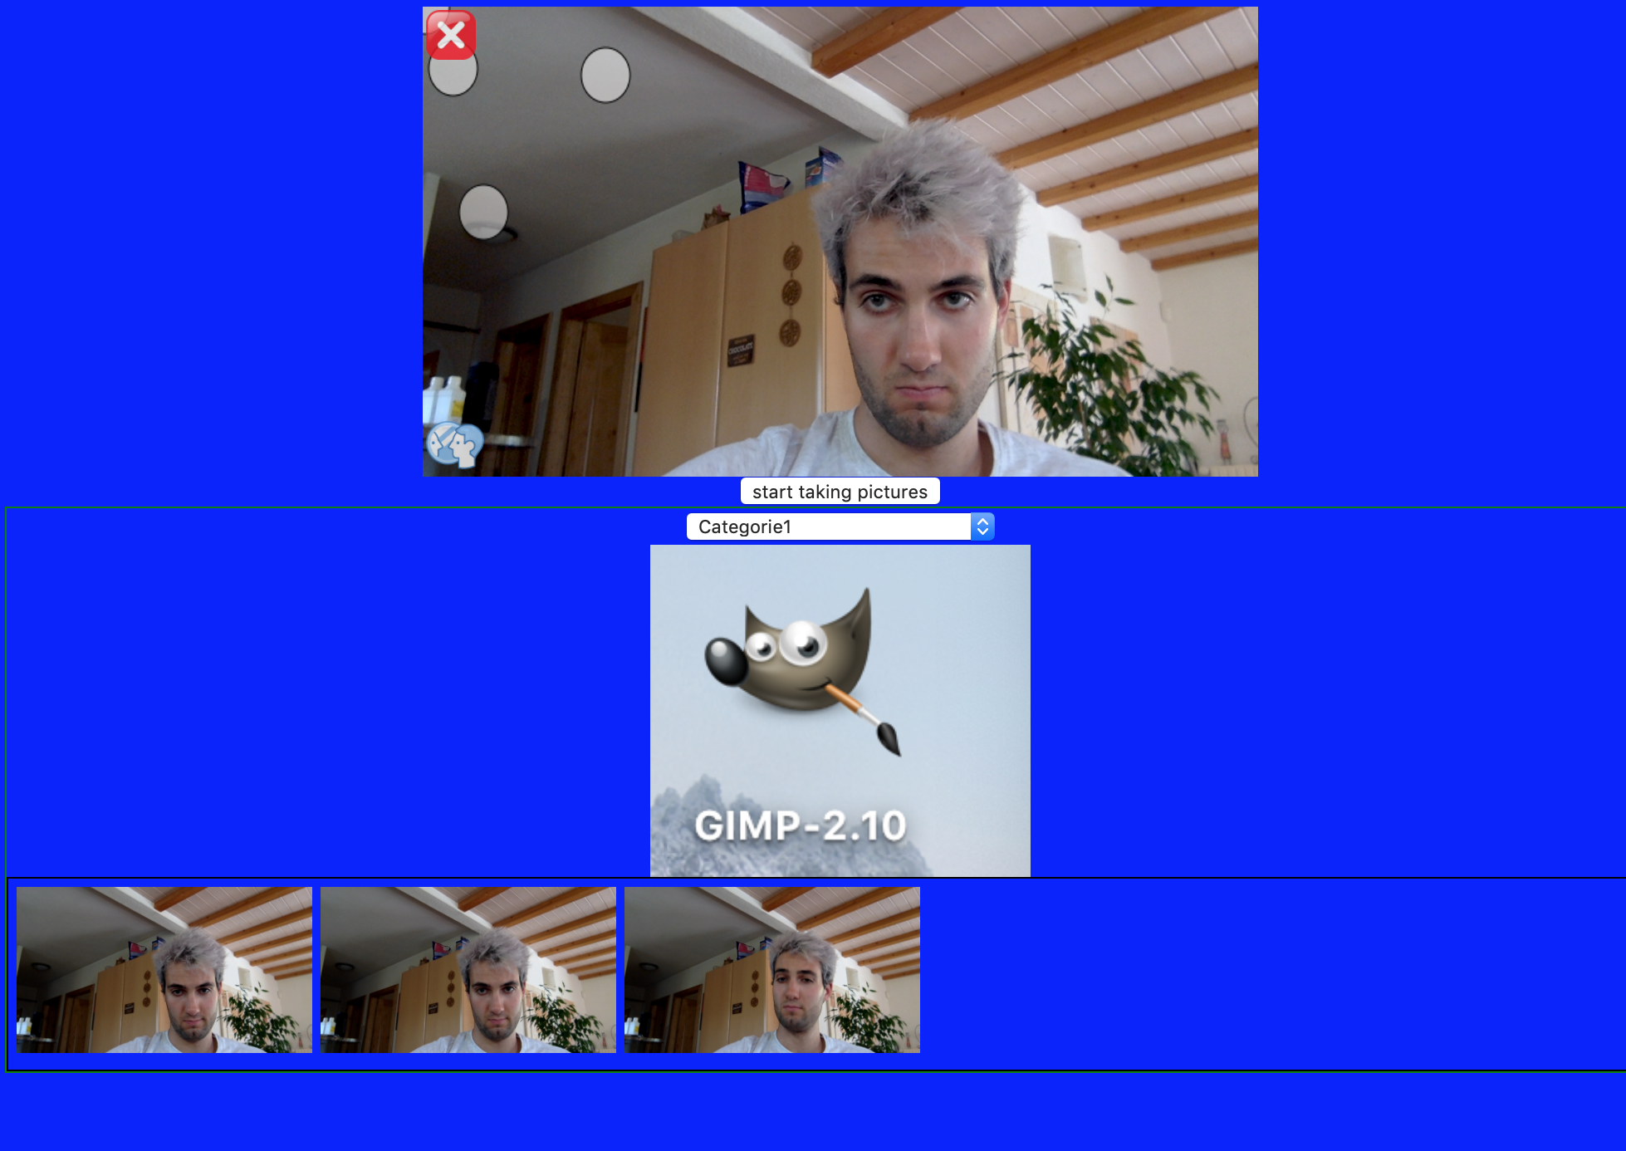
First weeks:
Followed some tutorial to handle the camera in a web browser
Then learned how to render the frame in a canvas to take some picture, and I did it in a loop
After 3rd week I had a new UI

Slide 22
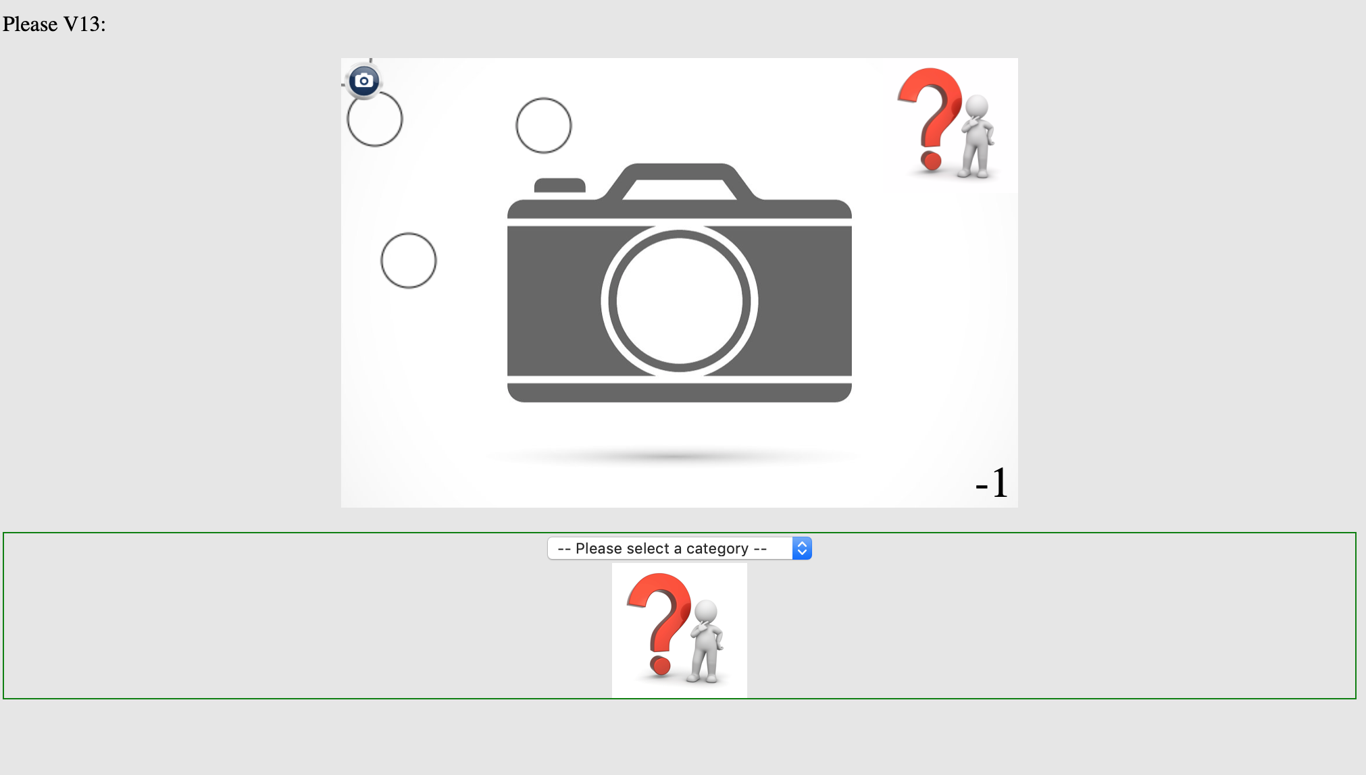
At week 5:

Slide 23
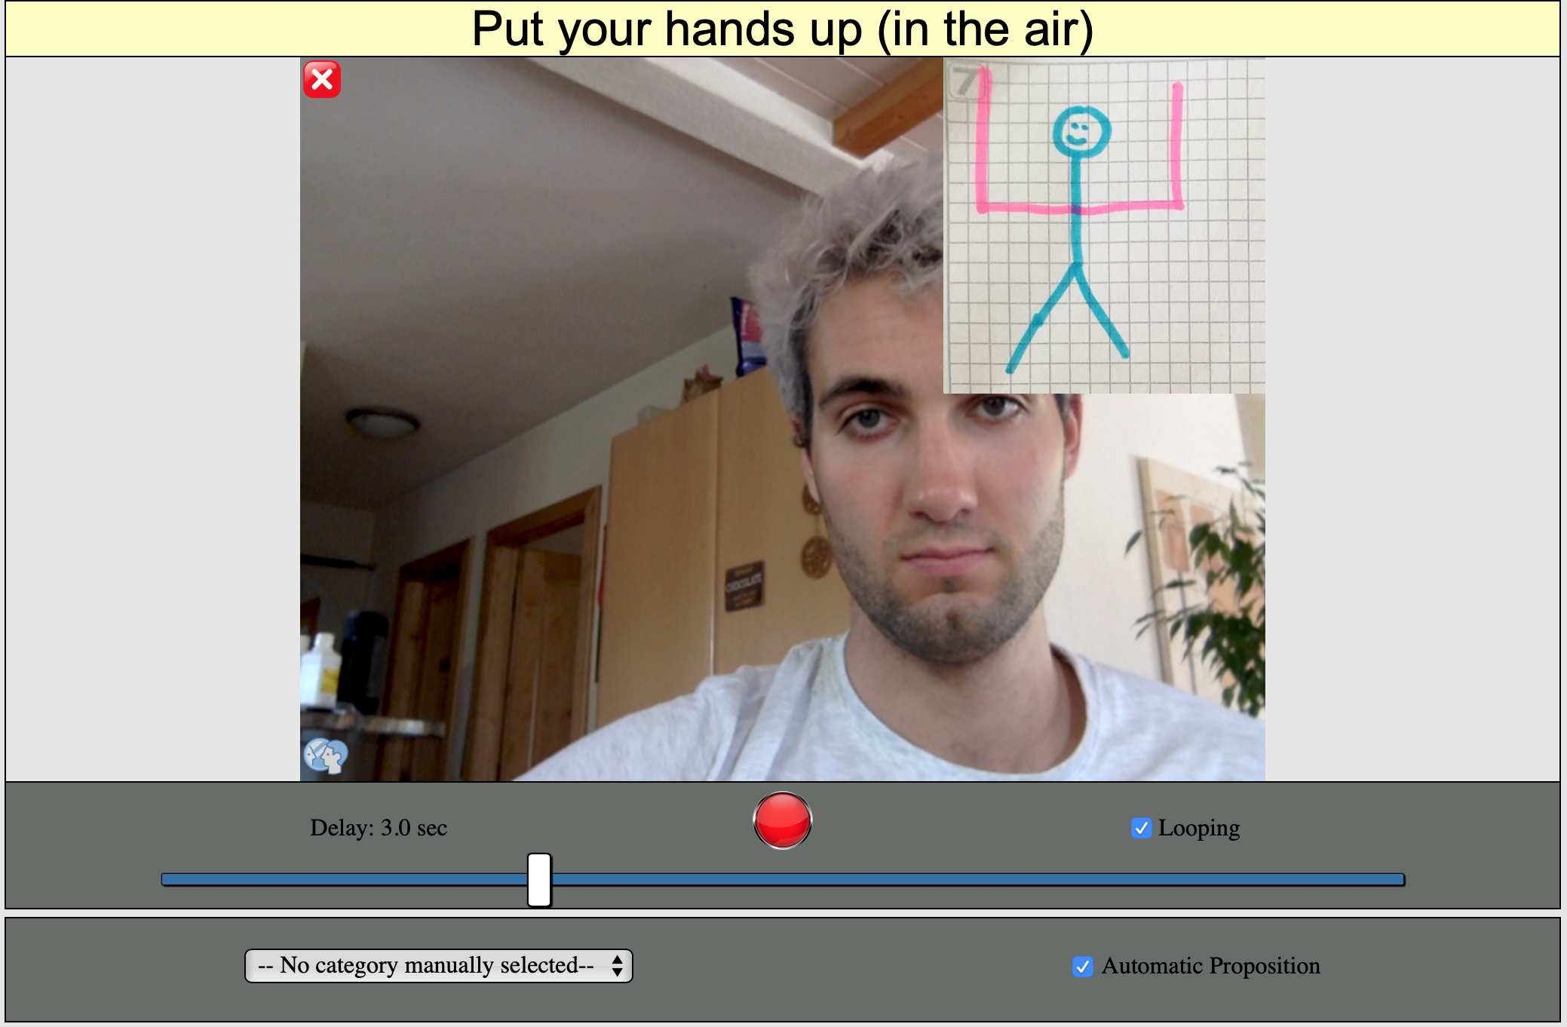
At week 7:

Slide 24
Week 9 ?

Slide 25
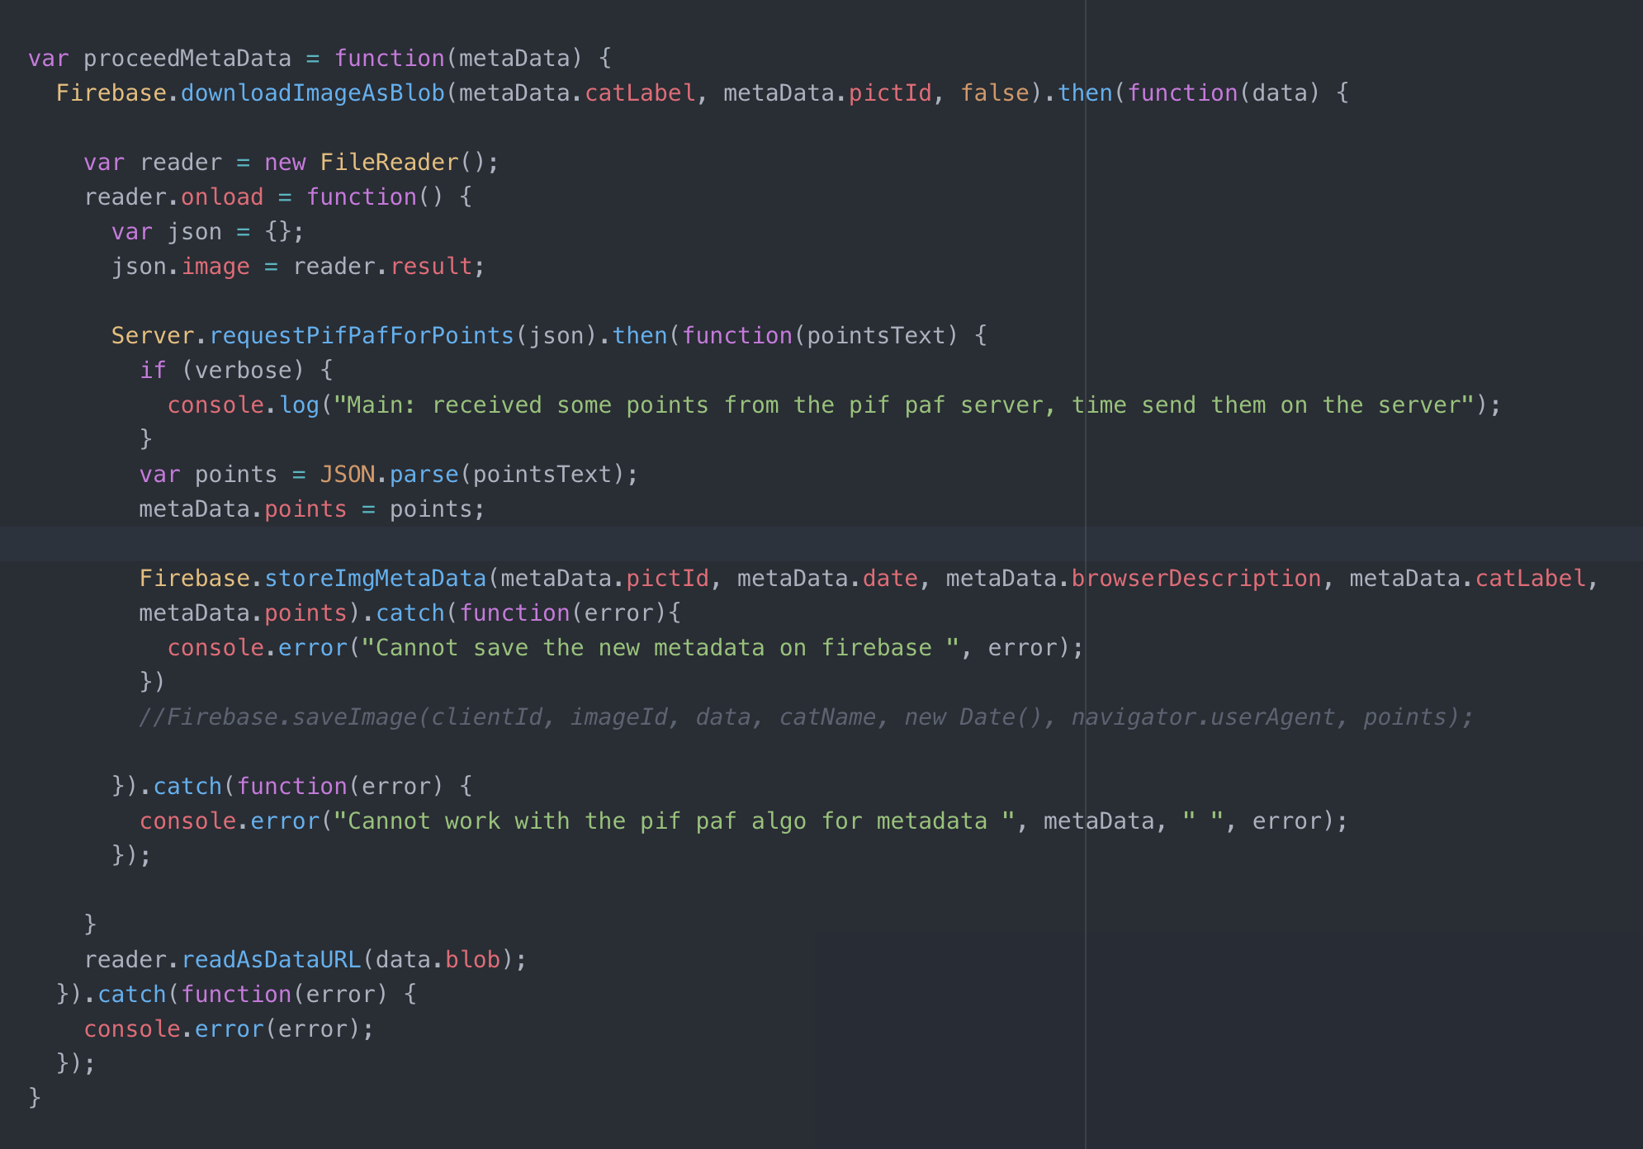
Week 10: download.js

Slide 26
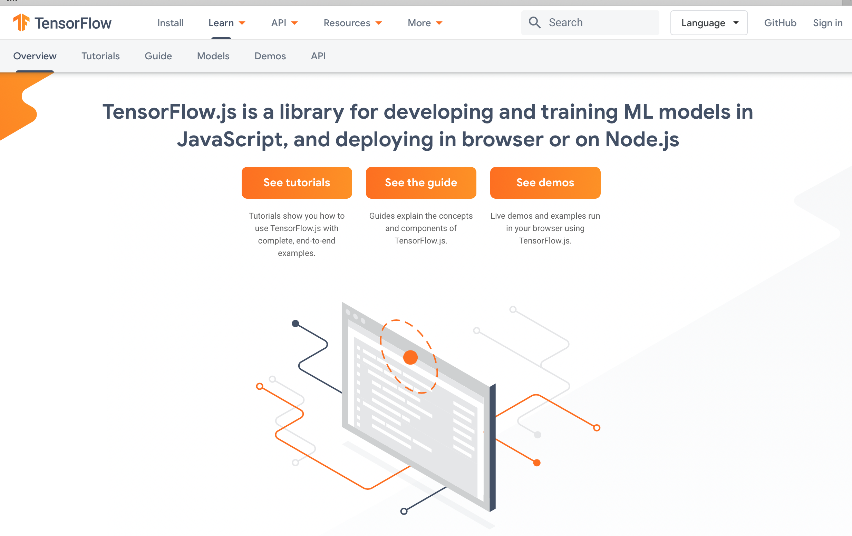
Week 11: TensorFlow.js

Slide 27
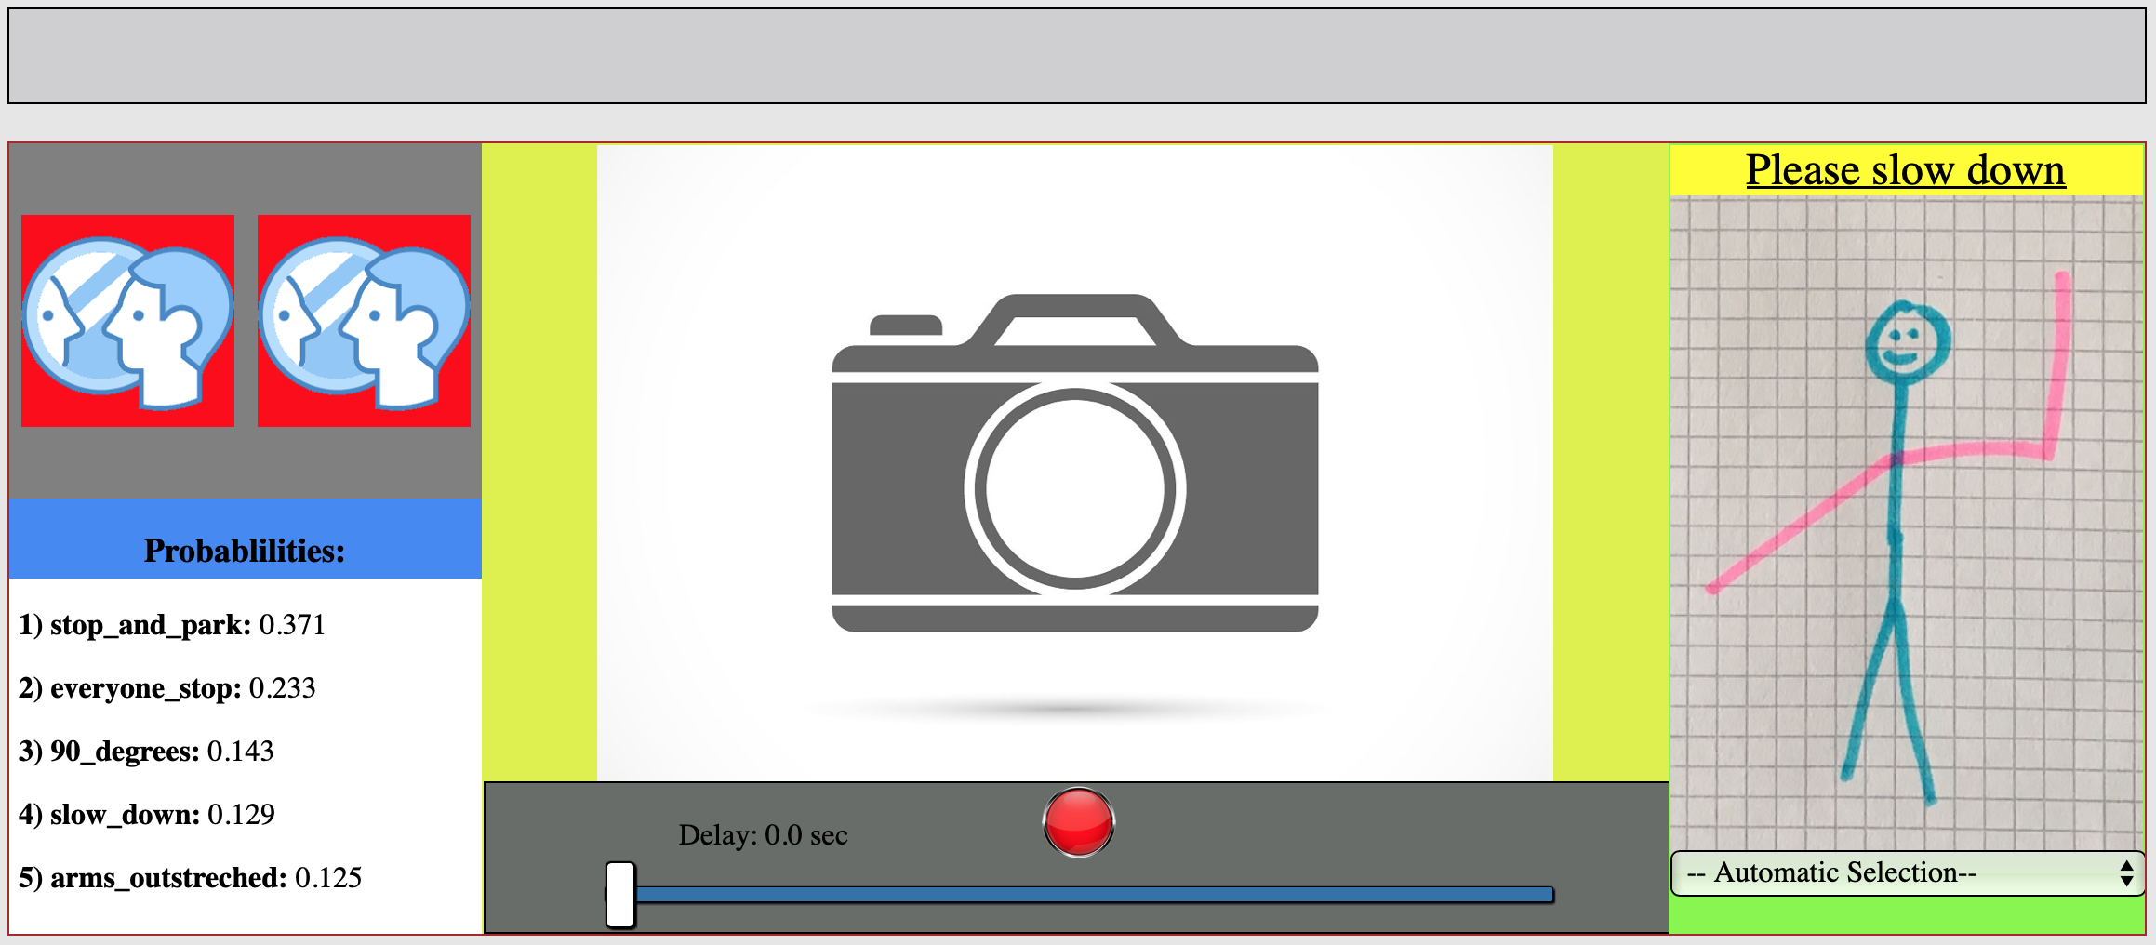
Week 12:
New Layout
Integration of TensorFlow.js

Slide 28
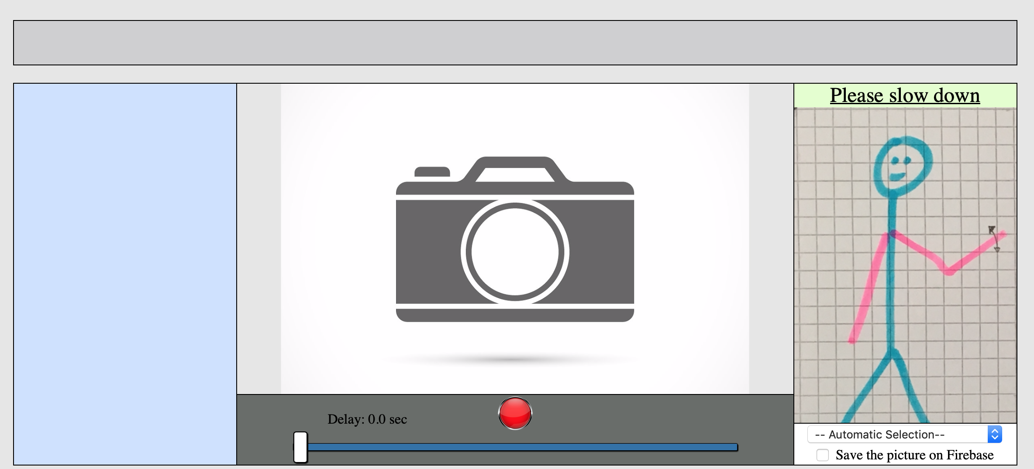
Week 13: the final layout

Slide 29
Week 14:
-Code Clean up
-Resolved Bugs
-Make the model work better
-…

Slide 30
Some Questions ??

